Slide 1

ACCESS
DENIEDED
PS-Sharing of Resources amongst different HEIS on their mutual agreement basis
PS Code-VS935.
Team Lead-Ambuj RaJ
Members-
Srishti Pandey
Sarthak Mondal
Chetan Amritanshu
Devanshu Gupta
Nisargi Marathe

Slide 2
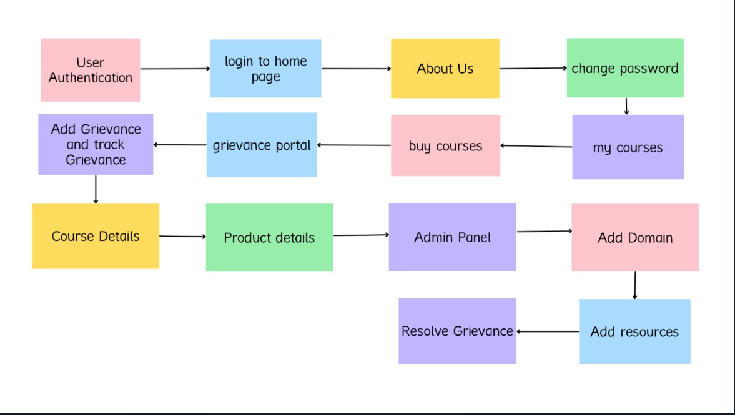
WORKFLOW

Slide 3
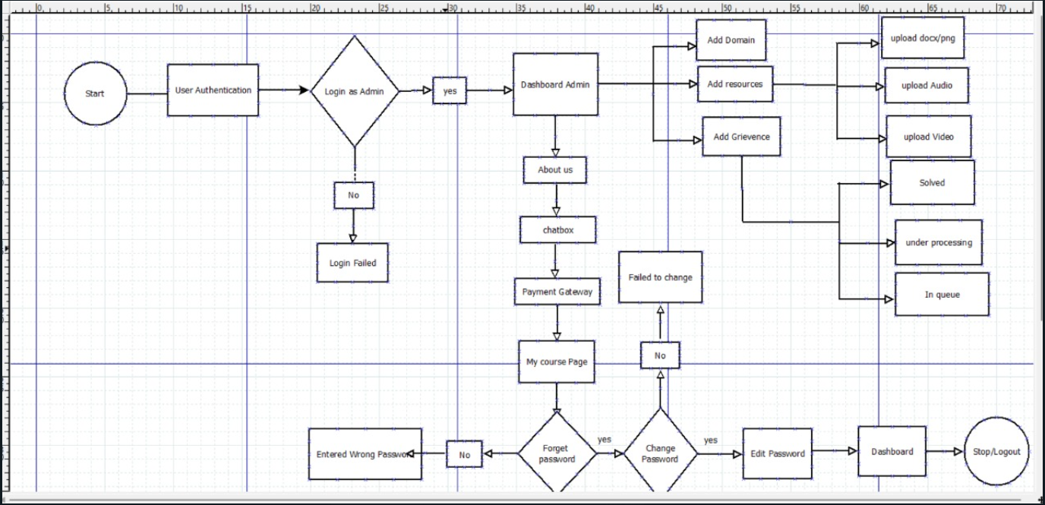
Use Case Diagram

Slide 4

Tech Stack Used
React,HTML,CSS
MongoDB,
JWT Authentication
Django
Formik
Yups
Postgres
For Frontend
For backend

Slide 5
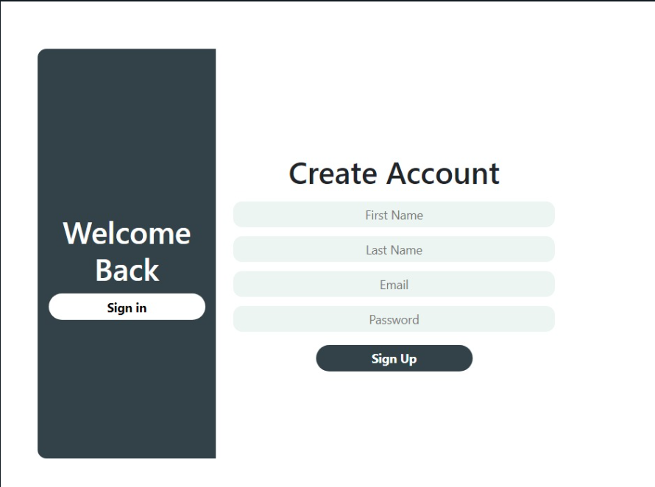
Web Authentication
Form validation using Formic and Yups.
JSON Web token, as a secure way to exchange information between two parties.
Incorporating a salt to protect against rainbow , table attacks,bcrypt.js is being used.

Slide 6
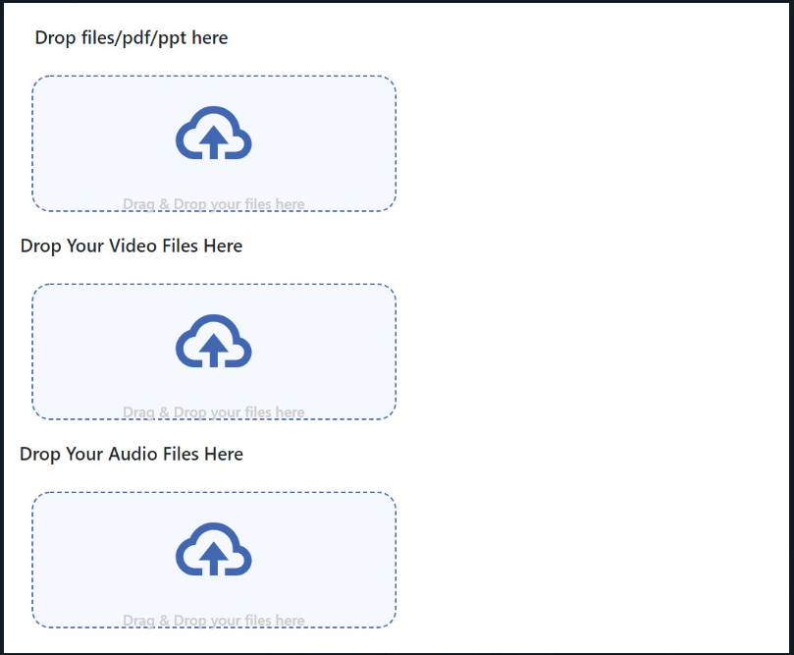
Add Resources
Providing 3 different ways of uploading resources via doc,txt,pdf.second one via audio files, and the third one via video files.

Slide 7
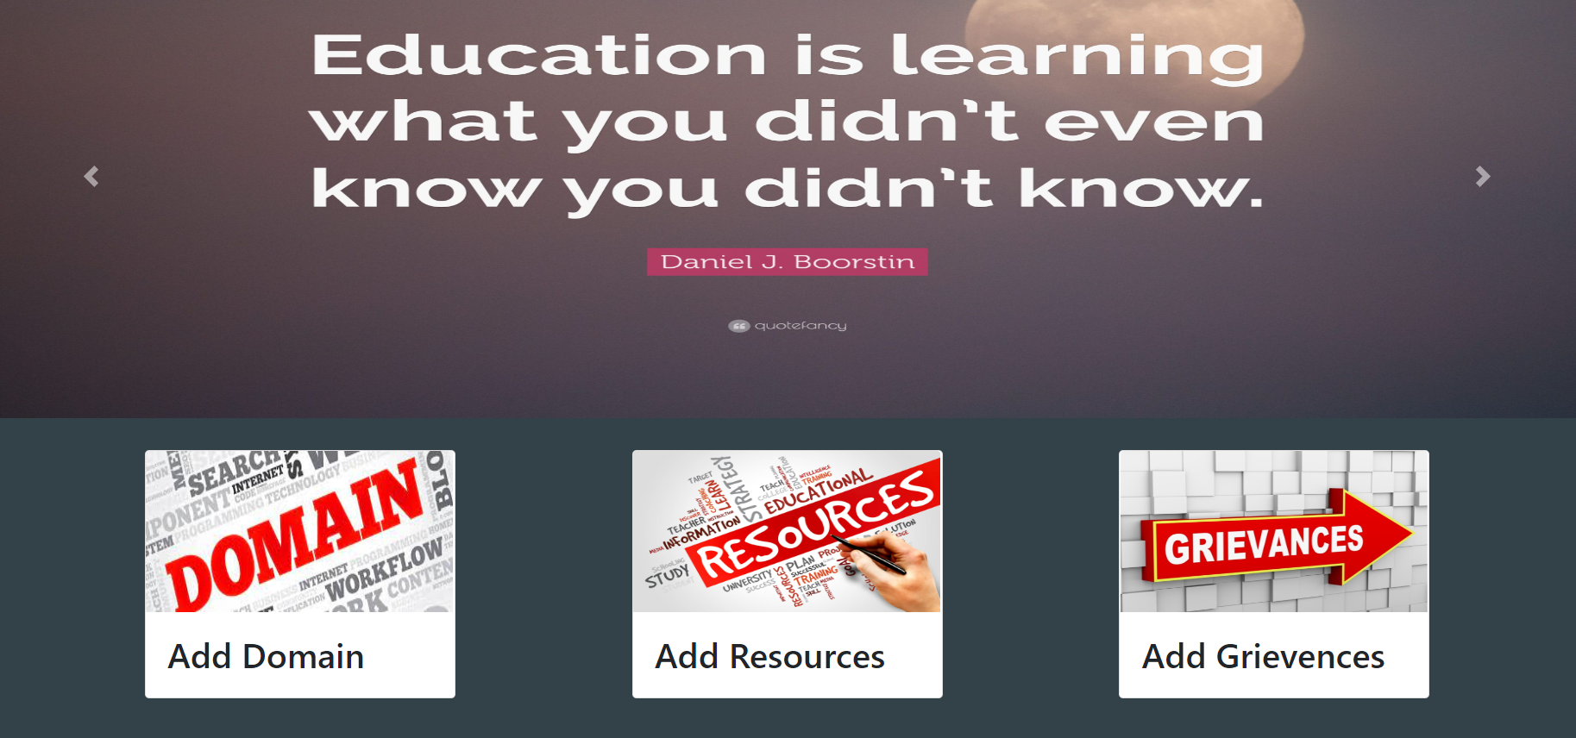
Admin Dashboard
This is a admin dashboard where we are providing our three main functions i.e Adding Domain,Adding Resources and Adding Griv

Slide 8
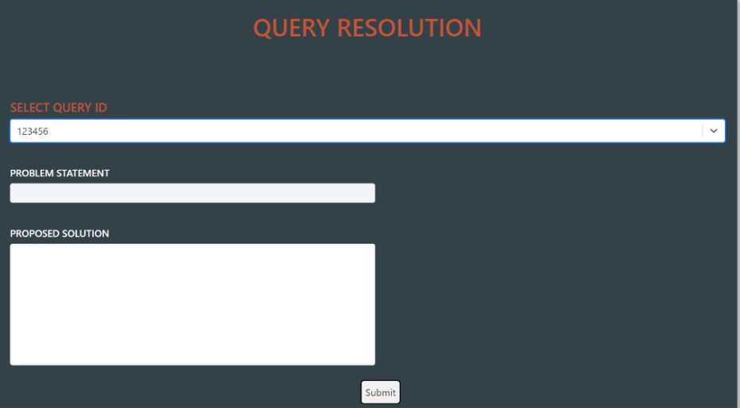
Grievance Resolution
This is the window to submit solutions to complaints/queries put up by users.

Slide 9
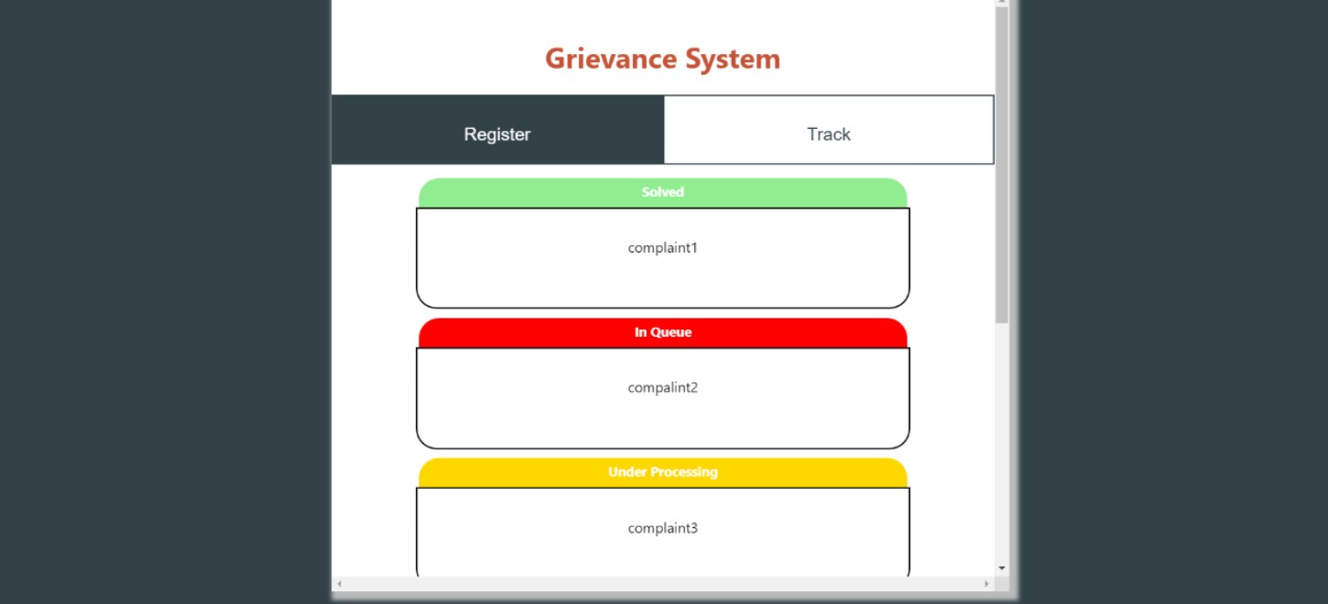

Slide 10
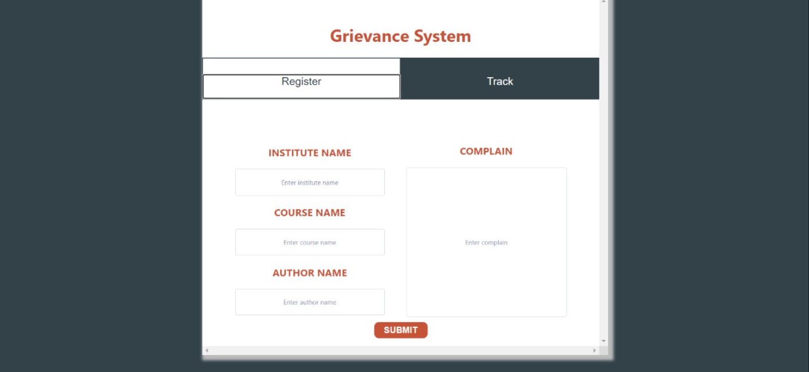
Grievance System Portal
it’s a Grievance Tracking System which shows the user submitted complaints along with their current statuses namely solved,inqueue and under processing.

Slide 11
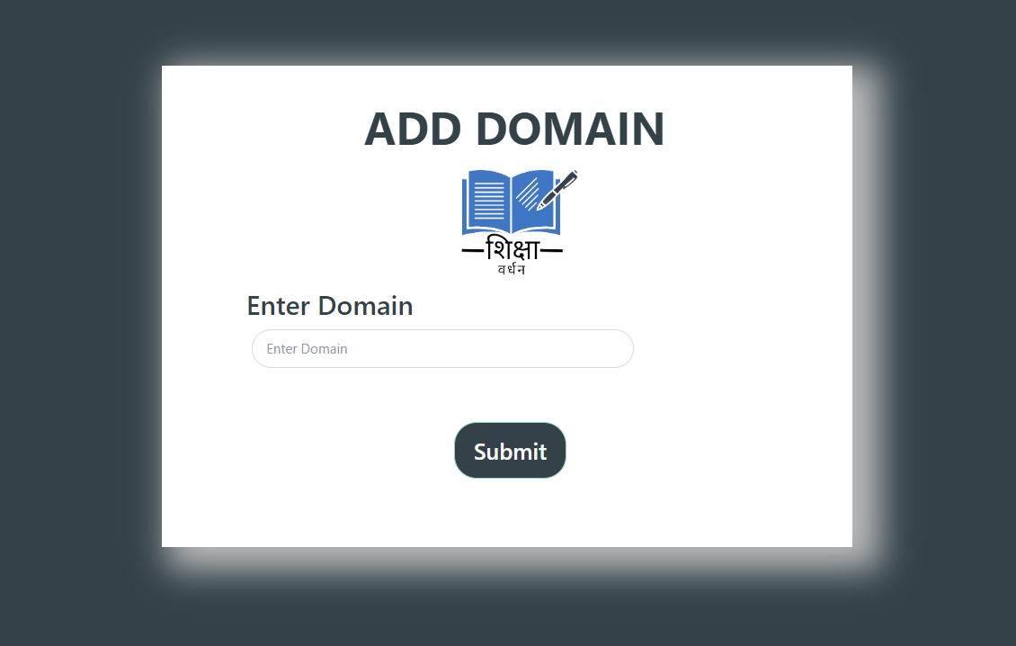
Add Domain
Here Aspirants HEIs will put their domain of interest of which they want resources to be uploaded.

Slide 12
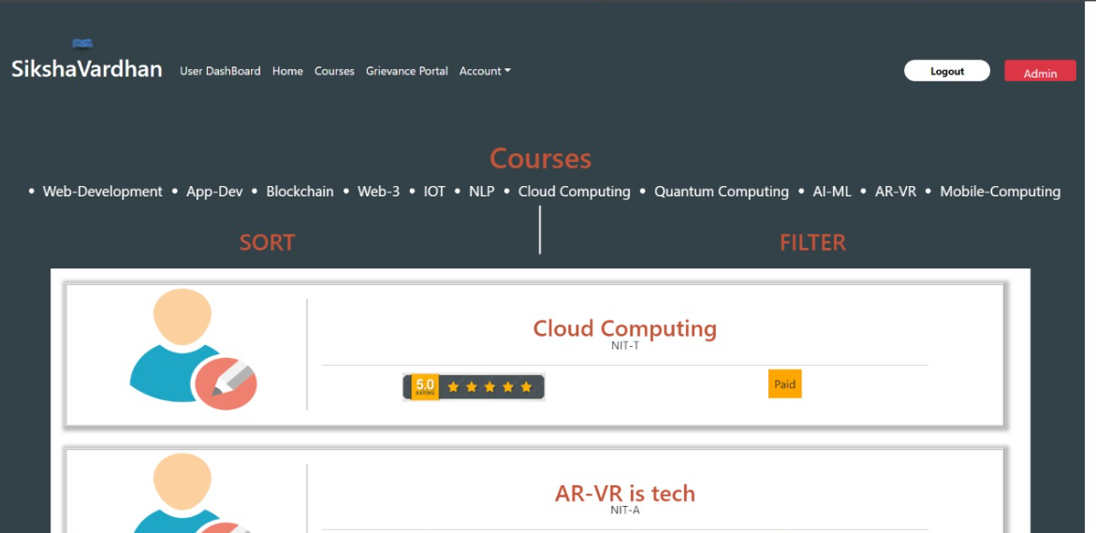
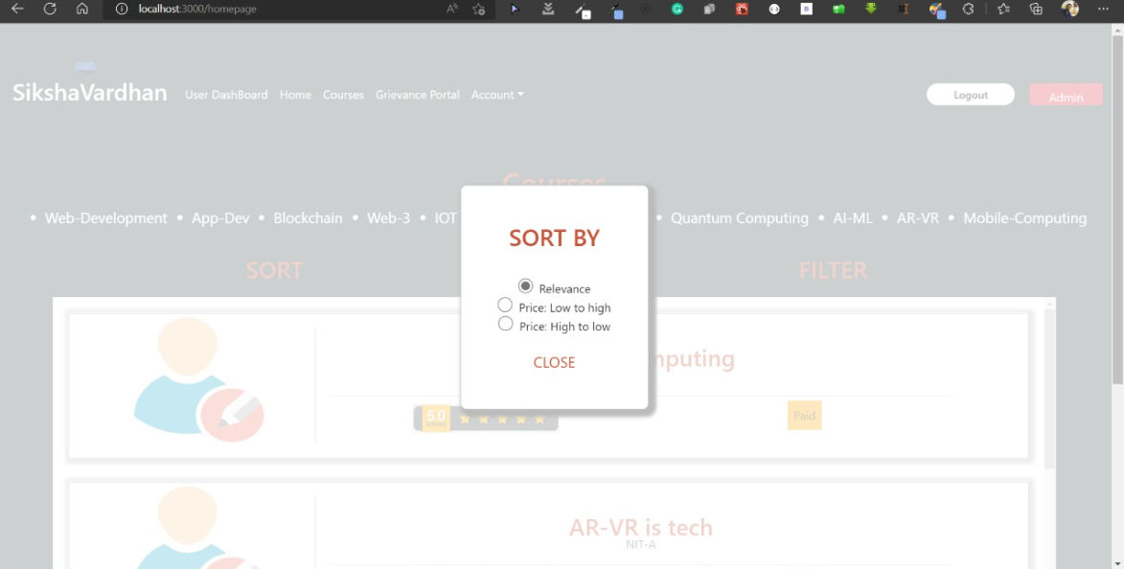
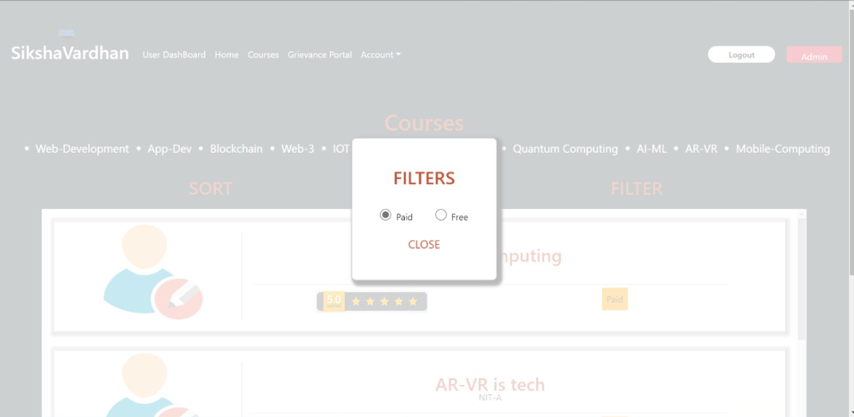
Available Courses
Here we are rendering all the resources as cards , all data being fetched using API’s. We are implementing sort functionality based on factors like user ratings, prices low to high and high to low as per the preference of the ser and in filters we are providing filters for paid and free resources both separated and also an additional filter if the user wishes to search resources based on the uploading institution.

Slide 13
Features Made for 3rd Pitch
Chat Bot
Change Password,About Us
1
4
My Course Page,Dashboard
Forget Password,Edit Profile
2
5
Payment Gateway
Grievance Resolution
3
6

Slide 14
About Us

Slide 15
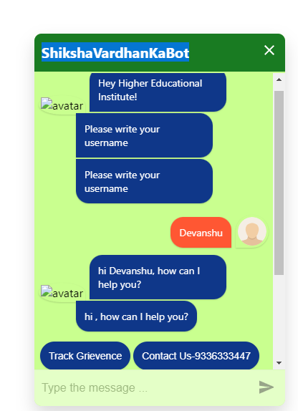
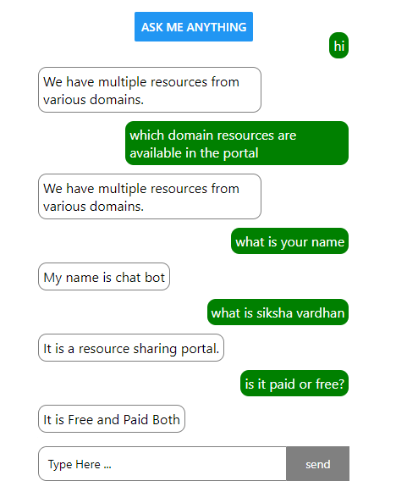
Chat Bot
This is a very interesting part of our portal which instantly solves the doubt of aspirant HEIs . If they are facing any issues regarding usage of the portal chat bot will easily solve all the query.
Insert
title here
Insert
title here
Insert
title here

Slide 16
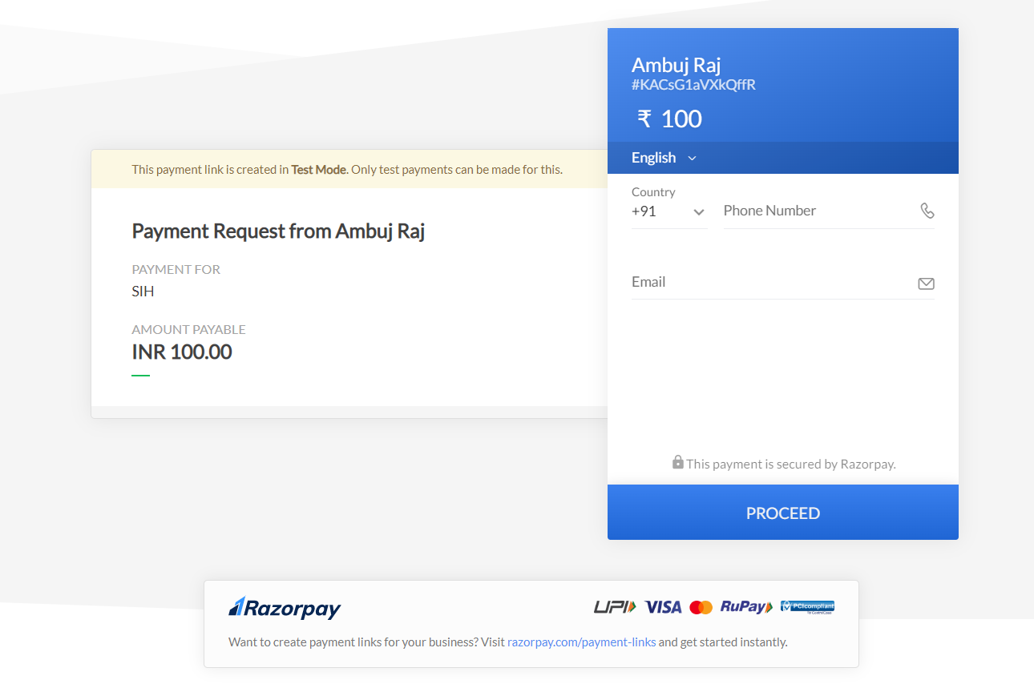
Payment Gateway
We are using razor pay payment gateway to initiate the payment for the resources.

Slide 17
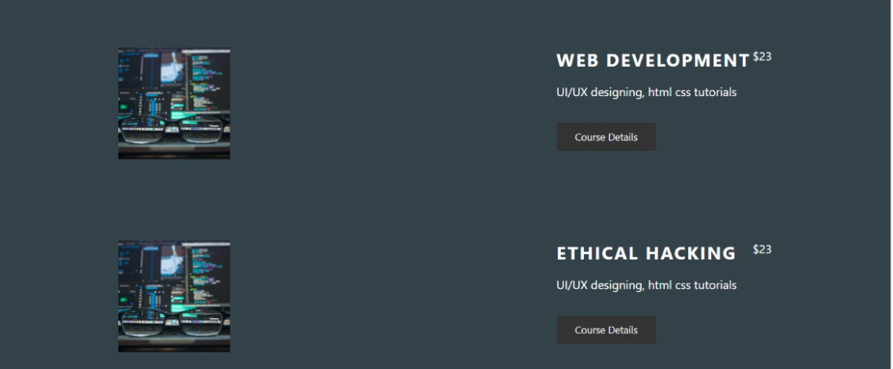
My Course Page

Slide 18
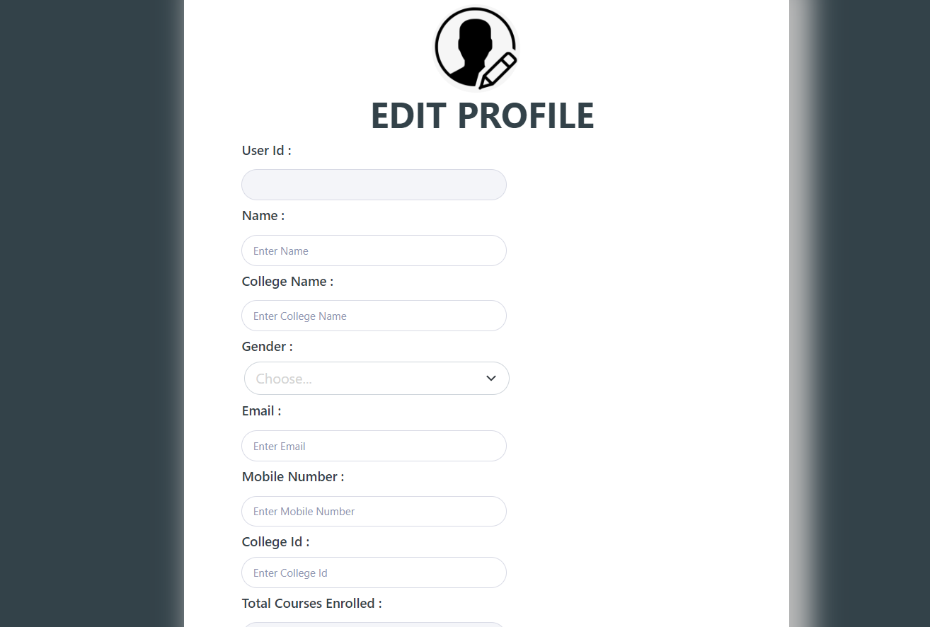
Edit Profile
Here Profile of User can be edited as per future needs of users.

Slide 19
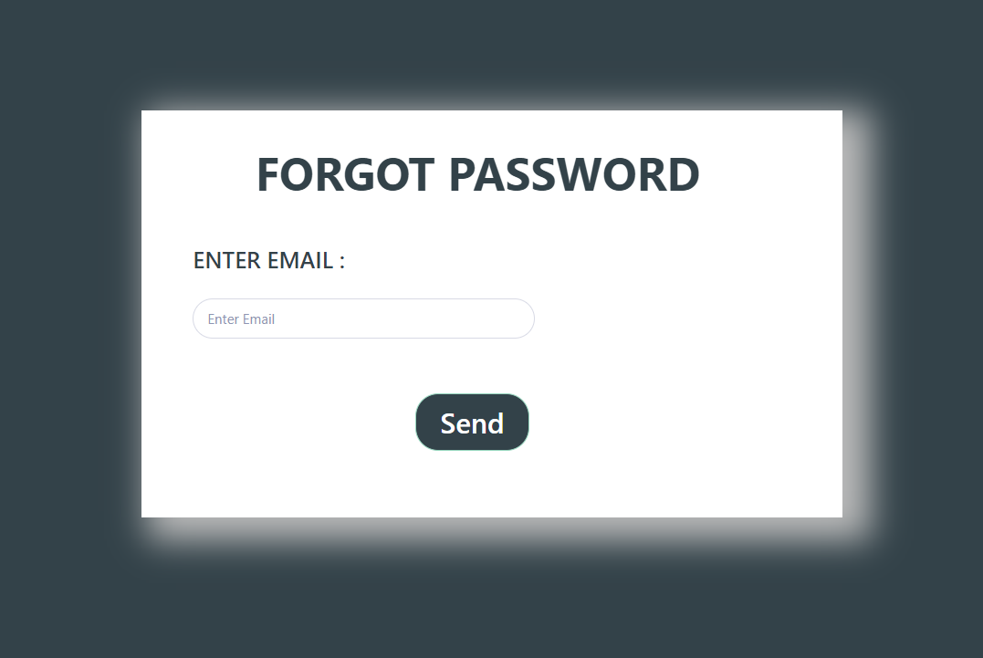
Forget Password
This is for the user who forgets his/her password so we can access forgot password page and generate new password.

Slide 20
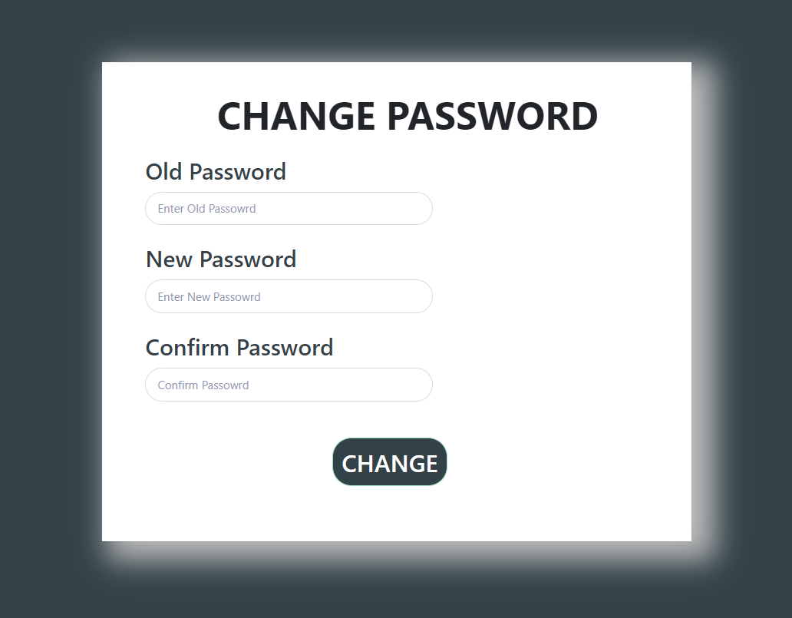
Change Password
This is for those users who wants to change their password ,for this he/she have to enter the old password then the password user wants to put and then confirm it ,and password is changed.

Slide 21
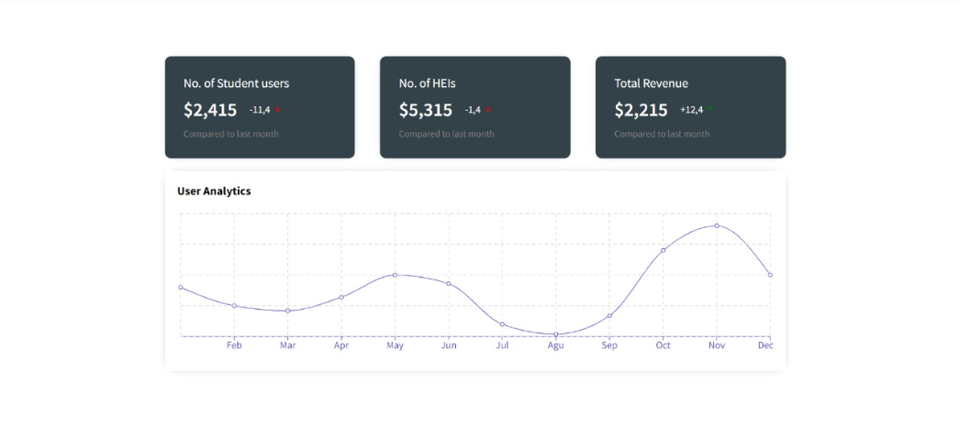
DashBoard
Dashboards are a great visual way to convey huge amounts of data in a structured manner .Hence we included a great informational dashboard to display data such as no. of institutions added, no of resources shared ,no of students reached, etc.

Slide 22



